Slide 1

PostgreSQL Introduction
SoftUni Team
Technical Trainers
Software University
https://softuni.org

Slide 2
Table of Contents
Data Management
Data Engine
Table Relations
Structured Query Language
PostgreSQL
Data Types
Basic SQL Commands
2
Notes:
2

Slide 3
Have a Question?
sli.do
#python-web
Notes:
3

Slide 4

Data Management
When Do We Need a Database?

Slide 5
Storage vs. Management
SALES RECEIPT
00315 – 07/16/2016
David Rivers
Oil Pump (OP147-0623)
1 x 69.90
Date: 07/16/2016
Order#:[00315]
Customer: David Rivers
Product: Oil Pump
S/N: OP147-0623
Unit Price: 69.90
Qty: 1
Total: 69.90

Slide 6
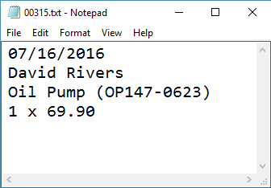
Storage vs. Management (2)
Order# | Date | Customer | Product | S/N | Qty
00315 | 07/16/2016 | David Rivers | Oil Pump | OP147-063 | 1

Slide 7

Storage vs. Management (3)
Storing data is not the primary reason to use a Database
Flat storage eventually runs into issues with
Size
Ease of updating
Searching
Security
Redundancy

Slide 8
Databases and DBMS
A database is an organized collection of related information
It imposes rules on the contained data
The user doesn't have direct access to the stored data
Access to data is usually provided by a DBMS
Data Base Management System
Provides tools to define, manipulate, retrieve and manage data in a database
Parses requests from the user and takes the appropriate action
8
Notes:
Show how it looks one database file

Slide 9


Database Engine

Slide 10



Database Engine Flow
Clients
Query
Engine
Access
Database
Data
Data

Slide 11
Database Table Elements
The table is the main building block of any database
Each row is called a record or entity
Columns (fields) define the type of data they contain
Column
CustomerID | FirstName | Birthdate | CityID
1 | Brigitte | 03/12/1975 | 101
2 | August | 27/05/1968 | 102
3 | Benjamin | 15/10/1988 | 103
4 | Denis | 07/01/1993 | 104
Row
Cell
Notes:
The table is the main unit of data storage. It has rows, columns and cells. Cells contain stored data. Each column has a data type. Types can be VARCHAR(String), INT, DATE etc.

Slide 12



Table Relations
Relational Database Model in Action

Slide 13
Relationships
Relationships between tables are based on interconnections: PRIMARY KEY / FOREIGN KEY
Primary key
Foreign key
towns
Primary key
id | name | country_id
1 | Sofia | 1
2 | Varna | 1
3 | Munich | 2
4 | Berlin | 2
5 | Moscow | 3
countries
id | name
1 | Bulgaria
2 | Germany
3 | Russia
Relationships

Slide 14
Why Split Related Data?
Empty records
first | last | registered | email
David | Rivers | 05/02/2016 | drivers@mail.cx
Sarah | Thorne | 07/17/2016 | sarah@mail.cx
Michael | Walters | 11/23/2015 | walters_michael@mail.cx
email2
david@homedomain.cx
NULL
NULL
Redundant information
order_id | date | customer | product | s/n | price
00315 | 07/16/2016 | David Rivers | Oil Pump | OP147-0623 | 69.90
00315 | 07/16/2016 | David Rivers | Accessory Belt | AB544-1648 | 149.99
00316 | 07/17/2016 | Sarah Thorne | Wiper Fluid | WF000-0001 | 99.90
00317 | 07/18/2016 | Michael Walters | Oil Pump | OP147-0623 | 69.90

Slide 15
Relationships (2)
The foreign key is an identifier of a record located in another table (usually its primary key)
By using relationships, we avoid repeating data in the database
Relationships have multiplicity:
One-to-many – e.g., mountains / peaks
Many-to-many – e.g., student / course
One-to-one – e.g., example driver / car

Slide 16
One-to-One
Primary key
Primary key
Foreign key
cars
drivers
car_id | driver_id
1 | 166
2 | 102
driver_id | driver_name
166 | …
102 | …
Relation
Notes:
In One-to-One relationship each row of table Cars is related to exactly zero or one row in table Drivers. In table Cars.DriverID is a foreign key which means that there will be a relation to another table – Drivers in the case. Table Drivers has a column DriverID as well which is a primary key. The relation is always between a foreign key and a primary key. It means that all values in Cars.DriverID should be present in Drivers. DriverID except NULL. Cars.DriverID can be NULL if it is not stated otherwise.

Slide 17
One-to-Many/Many-to-One
Primary key
Primary key
Foreign key
Mountains
Peaks
mountain_id | name
1 | Caucasus
peak_id | mountain_id
61 | 1
66 | 1
Relation
Notes:
One-to-Many relationship means that each row from a table is related zero, one or many rows in the referent table. In the case above, each mountain can have 0, 1 or many peaks. The example shows that the mountain Caucasus has two peaks - One-to-Many. If you look the other way around many peaks has exactly one mountain – Many-to-One.

Slide 18
Many-to-Many
Primary key
Primary key
employees
projects
employee_id | name
1 | …
40 | …
project_id | name
4 | …
24 | …
Mapping table
employees_projects
employee_id | project_id
1 | 4
1 | 24
40 | 24
Notes:
Many-to-Many relationship relates many rows from a table to many rows in another table. For example. Employee.EmployeeID has many projects. Many projects are assigned to many employees which is the other way around. Usually we have a mapping table that takes care of the relations.

Slide 19
Junction Tables
students
classrooms
student_id | name
1 | Peter
2 | George
classroom_id | number
1 | 10
2 | 20
student_classroom
student_id | classroom_id | pk_student_classroom
1 | 1 | 11
2 | 2 | 22
1 | 2 | 12
Combination of the 2 ids

Slide 20

Structured Query Language

Slide 21
Structured Query Language (1)
Programming language
Designed for managing data in a relational database
Used to communicate with the Engine
Developed at IBM in the early 1970s
Introduces the concept of accessing many records with one single command
Eliminates the need to specify how to reach a record

Slide 22
Structured Query Language (2)
Subdivided into several language elements
Queries
Clauses
Expressions
Predicates
Statements
Update clause
Expression
UPDATE employees
SET salary = salary * 0.1
WHERE job_title = "Cashier";
Statement
Predicate

Slide 23
Structured Query Language (3)
Logically divided in four sections
Data Definition – describe the structure of our data
CREATE, ALTER, DROP
Data Manipulation – store and retrieve data
SELECT, INSERT, UPDATE, DELETE
Data Control – define who can access the data
GRANT, REVOKE, DENY
Transaction Control – bundle operations and allow rollback
COMMIT, ROLLBACK, SAVE

Slide 24
SQL vs NoSQL
SQL:
Relational database management system
Predefined Schema
Suited for complex queries
Vertically scalable
NoSQL:
Non-relational database system
Dynamic Schema
Suited for hierarchical data storage
Horizontally scalable

Slide 25

PostgreSQL

Slide 26
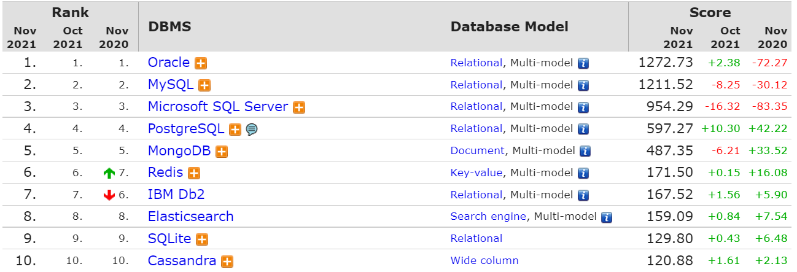
What is PostgreSQL?
Object–Relational Database Management System (ORDBMS)
Widely used open-source cross-platform system

Slide 27
What makes PostgreSQL stand out?
First DBMS that implements multi-version concurrency control feature
Able to add custom functions
Designed to be extensible
Defining custom data types, plugins, etc.
Very active community

Slide 28
Download and Installation
Download PostgreSQL 14 and PgAdmin 4
https://www.postgresql.org/download/

Slide 29
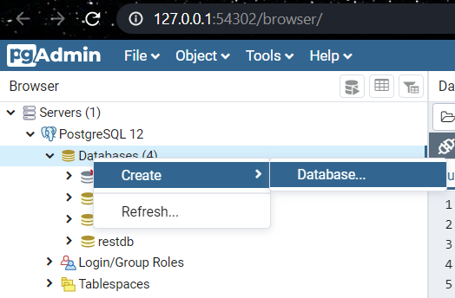
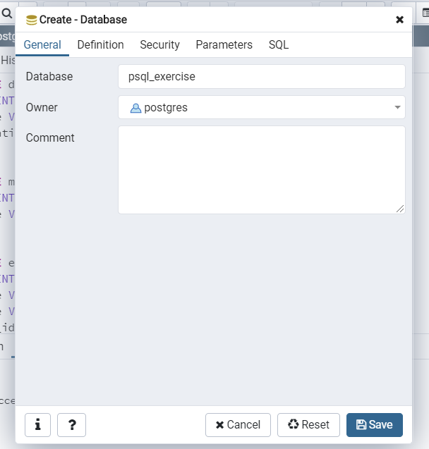
Create a New Database in pgAdmin 4
29

Slide 30
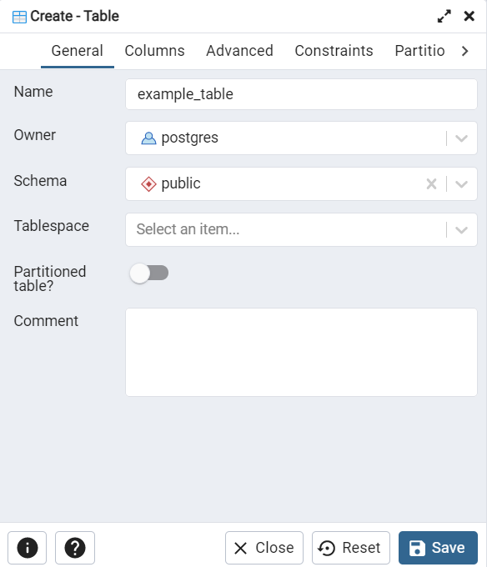
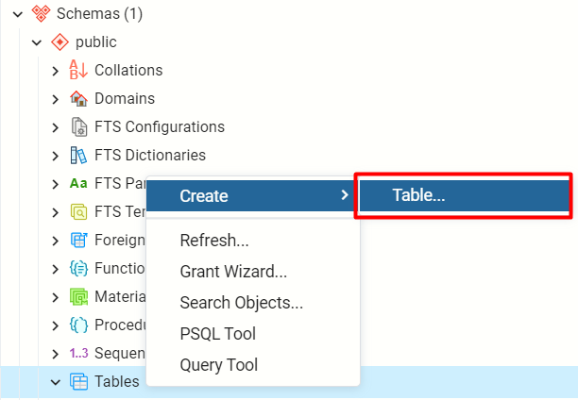
Create a new Table (1)
Right click on the Database/ Schemas/ Tables
30

Slide 31
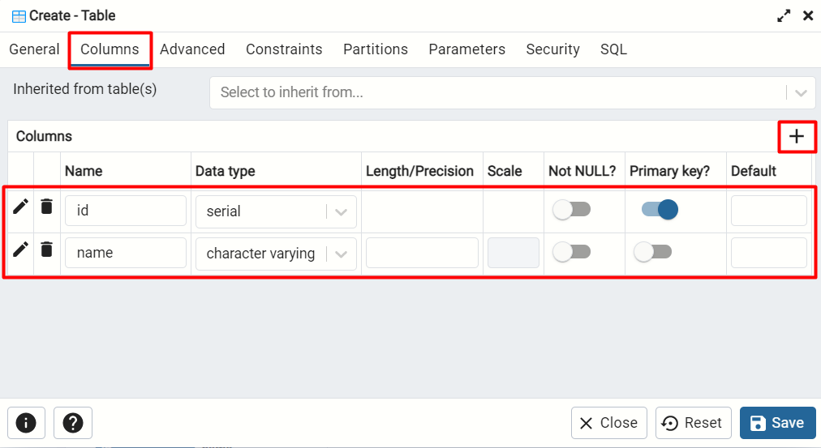
Create a new Table (2)
Create columns in the table
31

Slide 32
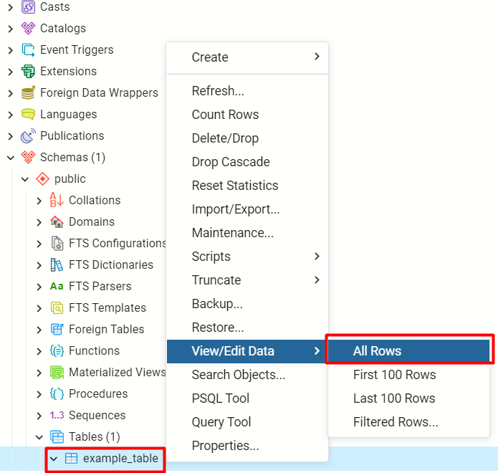
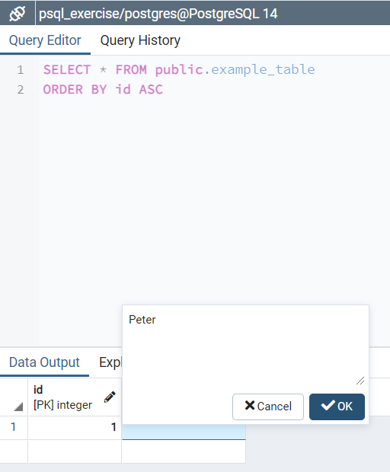
View/ Edit Data
Right click on the created table example_table
32

Slide 33
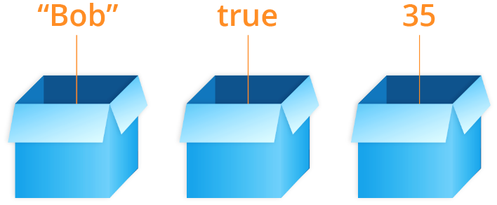
Data Types

Slide 34
String Types
CHARACTER/CHAR[(M)]
Fixed-length e.g., CHAR(30)
CHAR without the length specifier (m) is the same as CHAR(1)
CHARACTER VARYING/VARCHAR[(N)]
Variable-length with limit e.g., VARCHAR(30)
VARCHAR without (n) can store a string with unlimited length
TEXT
Stores strings of any length

Slide 35
Numeric Data Types
Integer types
SMALLINT, INTEGER/INT, BIGINT
Arbitrary Precision Numbers
DECIMAL, NUMERIC
Floating-Point Types
REAL, DOUBLE PRECISION
Serial Types
SMALLSERIAL, SERIAL, BIGSERIAL
The type INTEGER/INT is the common choice
Recommended for storing quantities where exactness is required
Storing and retrieving a value might show a slight difference
Used for creating unique identifier columns

Slide 36
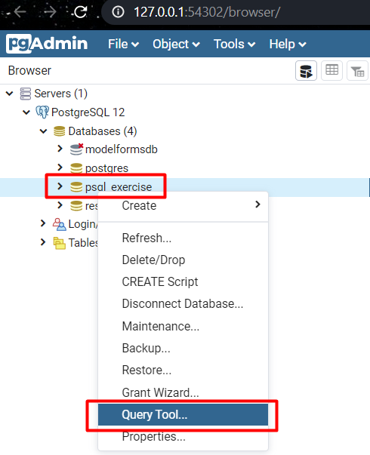
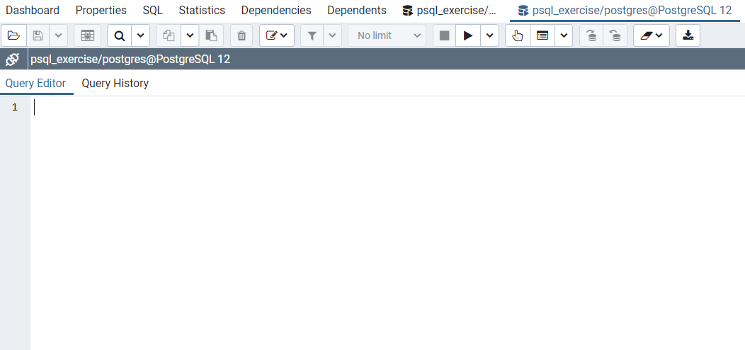
Open the Query Tool
Write SQL here

Slide 37
Example (1)
CREATE TABLE department (
dep_id SERIAL,
dep_name VARCHAR (20),
dep_location VARCHAR
);
CREATE TABLE manager (
man_id SERIAL,
man_name VARCHAR (15)
);
Column name
Data type

Slide 38
Date Types
DATE - for values with a date part but no time part
2016-06-23
TIME - for values with time but no date part
14:01:10
TIMESTAMP - both date and time parts
2020-10-05 14:01:10
TIMESTAMPTZ - both date and time parts with time zone
2020-10-05 14:01:10+02:00

Slide 39
Custom Column Properties
Primary Key
Foreign Key
Unique constraint – no repeating values in entire table
Default value – if not specified (otherwise set to NULL)
id SERIAL PRIMARY KEY
fk_column_name REFERENCES parent_table
email VARCHAR(50) UNIQUE
balance DECIMAL(10,2) DEFAULT 0

Slide 40
Example (2)
CREATE TABLE task (
task_id SERIAL PRIMARY KEY,
manager_id INT,
dep_id INT,
task_title TEXT UNIQUE,
start_date DATE NOT NULL DEFAULT CURRENT_DATE,
due_date DATE,
due_time TIME,
manager_id REFERENCES manager,
dep_id REFERENCES department
);
Custom properties

Slide 41
Basic SQL Commands
CREATE TABLE people (
id INT NOT NULL,
email VARCHAR NOT NULL,
first_name VARCHAR(50),
last_name VARCHAR(50)
);
Create, Read, Update, Delete

Slide 42
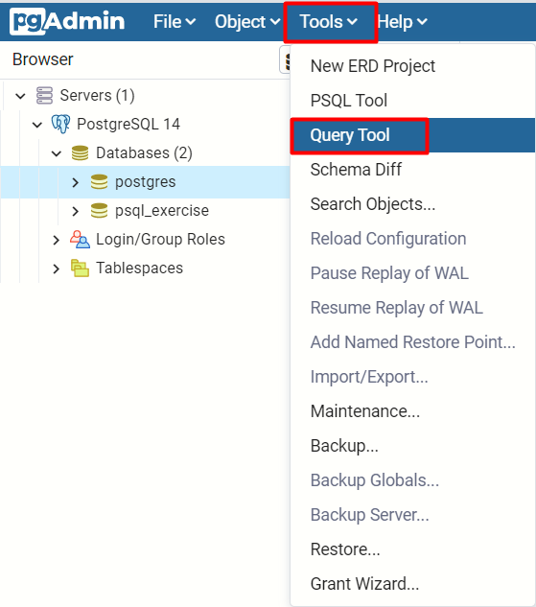
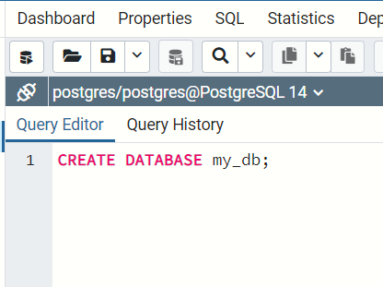
Create a Database Using SQL
Click on Tools/ Query Tool and the following code
Database name

Slide 43
Create a Table Using SQL
Table name
CREATE TABLE people
(
id SERIAL PRIMARY KEY,
email VARCHAR (50) NOT NULL,
first_name VARCHAR (50),
last_name VARCHAR (50)
);

Slide 44
Inserting Data Using SQL
Values for
all columns
The SQL INSERT command
Bulk data can be recorded in a single query, separated by comma
INSERT INTO towns VALUES (33, 'Paris');
Specify
columns
INSERT INTO projects(name, start_date)
VALUES ('Reflective Jacket', NOW());
INSERT INTO employees_projects
VALUES (229, 1),
(229, 2),
(229, 3), …

Slide 45
Problems: Create and Insert
Create new Database "game_bar"
Create Tables:
employees – id, first_name, last_name
categories – id, name
products – id, name, category_id
Insert Data:
Populate the employees table with 3 test values

Slide 46
Retrieve/Read Records Using SQL
Get all information from a table
You can limit the columns and number of records
SELECT * FROM people;
* for all
Table name
SELECT first_name, last_name FROM people LIMIT 5;
List of columns
Number of records

Slide 47
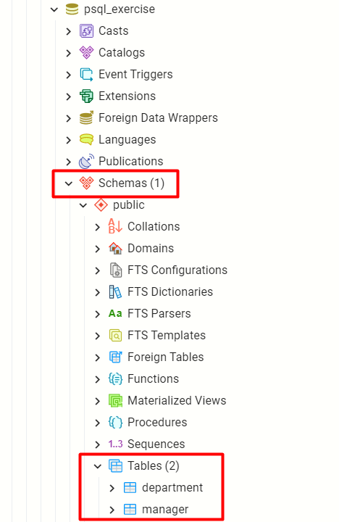
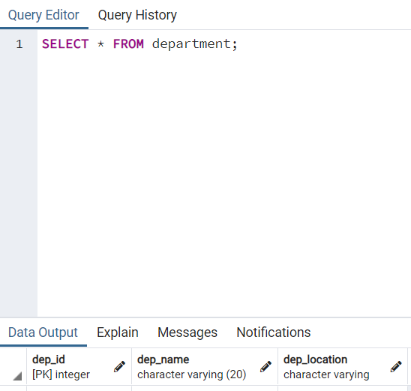
Example

Slide 48
Deleting from Database
Deleting structures is called dropping
You can drop keys, constraints, tables and entire databases
Deleting all data in a table is called truncating
Both actions cannot be undone – use with caution!

Slide 49
Dropping and Truncating
To delete all the entries in a table
To drop a table – delete data and structure
To drop entire database
TRUNCATE TABLE employees;
Table name
DROP TABLE employees;
Table name
Database name
DROP DATABASE soft_uni;

Slide 50
Altering Tables Using SQL (1)
A table can be changed using the keywords ALTER TABLE
Add new column
ALTER TABLE employees;
Table name
ALTER TABLE employees
ADD COLUMN salary DECIMAL;
Column name
Data type

Slide 51
Altering Tables Using SQL (2)
Delete existing column
Modify data type of existing column
Column name
ALTER TABLE people
DROP COLUMN full_name;
ALTER TABLE people MODIFY COLUMN email VARCHAR(100);
Column name
New data type

Slide 52
Altering Tables Using SQL (3)
Add primary key to existing column
Add unique constraint
Constraint name
ALTER TABLE people ADD CONSTRAINT pk_id
PRIMARY KEY (id);
Column name
(more than one for composite key)
Constraint name
ALTER TABLE people ADD CONSTRAINT uq_email
UNIQUE (email)
Column name(s)

Slide 53
Altering Tables Using SQL (4)
Set default value
Default value
ALTER TABLE people ALTER COLUMN balance SET DEFAULT 0;
Column name

Slide 54
Altering Tables Using SQL (5)
To remove a specified constraint from a table
Primary keys, value constraints and unique fields
To remove DEFAULT value (if not specified, revert to NULL)
Table name
ALTER TABLE employess DROP CONSTRAINT pk_id;
Constraint name
Table name
ALTER TABLE employess ALTER COLUMN clients
DROP DEFAULT;
Column name

Slide 55
Problems: Alter Tables
Alter table
Add a new column – "middle_name" to the "employees" table
Adding Constraints
Make "category_id" foreign key linked to "id" in the "categories" table
Modifying Columns
Change the property "VARCHAR(50)" to "VARCHAR(100)" to the "middle_name" column in "employees" table

Slide 56

Live Demo
Writing SQL in pgAdmin 4

Slide 57

Summary
…
…
…
Data Management
Data Engine
Table Relations
Structured Query Language
PostgreSQL
Data Types
Basic SQL Queries

Slide 58
Questions?
Notes:
58

Slide 59











SoftUni Diamond Partners

Slide 60


Educational Partners

Slide 61

License
This course (slides, examples, demos, exercises, homework, documents, videos and other assets) is copyrighted content
Unauthorized copy, reproduction or use is illegal
© SoftUni – https://softuni.org
© Software University – https://softuni.bg
Notes:
61

Slide 62
Trainings @ Software University (SoftUni)
Software University – High-Quality Education, Profession and Job for Software Developers
softuni.bg, softuni.org
Software University Foundation
softuni.foundation
Software University @ Facebook
facebook.com/SoftwareUniversity
Software University Forums
forum.softuni.bg
Notes:
62

